Slide 1
Feature Selection and Cluster Analysis in Drug Utilisation Research

Slide 2
Introduction
The purpose of the paper is to detect features and sub-groups related to drug use within a population by phenotyping and discovery using unsupervised ML.
Phenotyping:- identifying features that are representative of the population from raw patient data. Example PCA, Autoencoders, etc.
Discovery:- Analysing features, to identify patterns in the population such as sub-groups and to predict outcomes. Example k-means, decision trees, Agglomerative Clustering, etc.

Slide 3
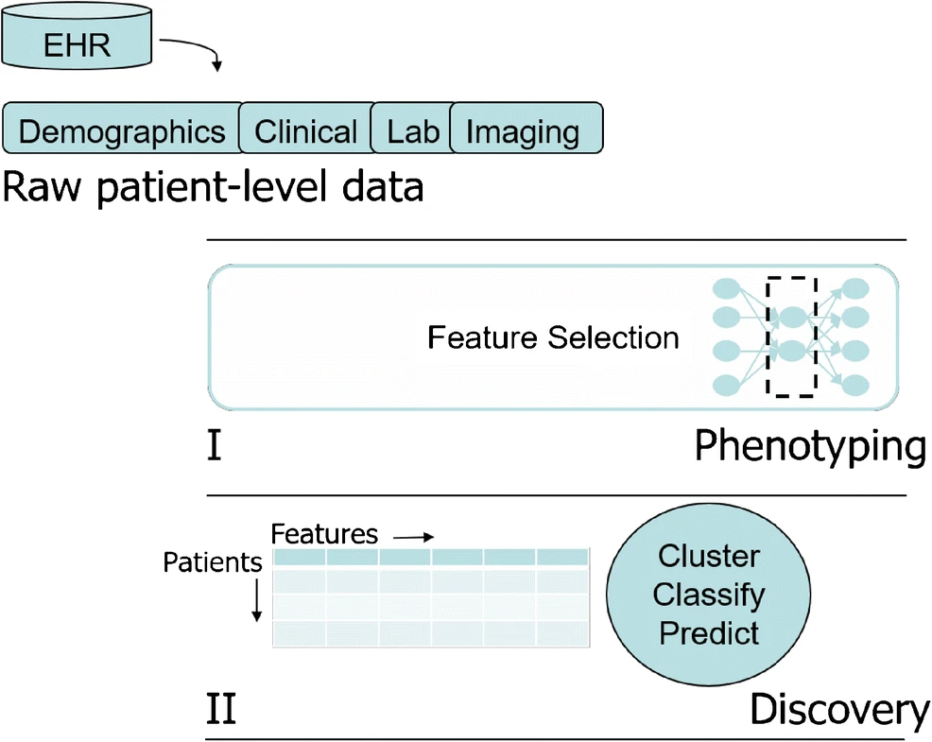
Chart

Slide 4
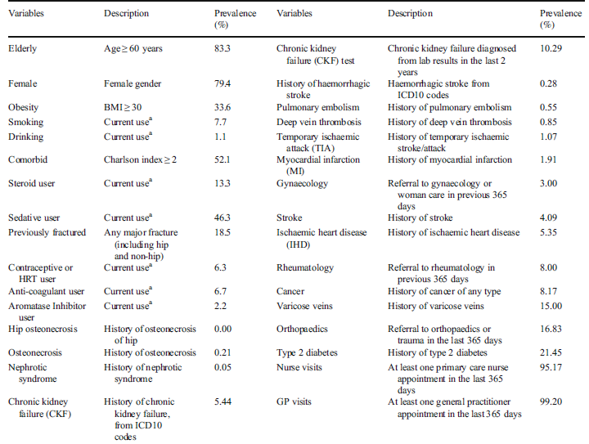
Dataset.
SIDIAP database were used, from which 32 features from 37,996 patients using anti-osteoporosis drugs were used.

Slide 5
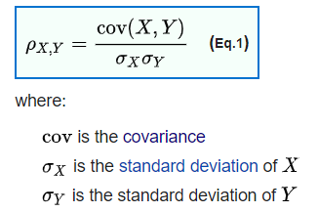
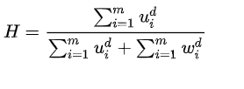
Clustering Tendency and Linear Dependency of the features
A] Pearson correlation coefficient: A value of +1 is total positive linear correlation, 0 is no linear correlation, and −1 is total negative linear correlation.
Had r less than 0.6, indicating no linear dependency among the pair of features.
B] Hopkins statistics:-
The value of 0.44 was obtained which indicates the data is randomly distributed.

Slide 6
Feature Selection-Using Sparse Autoencoder.
*The autoencoder is an unsupervised learning algorithm for feature selection using unlabelled data.
*The optimal architecture is one for which the two parameters (hidden layer, sparsity parameter) result in the smallest reconstruction error between X and X^.
*Wdj, the weight assigned to the dth variable at the jth node of the hidden layer, can be used to generate a measure of the “importance” of that variable in the reconstruction of the dataset.
*The greater the weight of a variable, the more important it was for the activation. Therefore the average weight of a variable across all of the node is considered.
*To identify the number of hidden nodes, J, and sparsity parameter, ρ, of the optimal autoencoder, grid search is performed.
*Feature selection was applied to a subset of the data containing 12 variables that are considered risk factors in the osteoporosis literature and to the full dataset containing 32 variables.

Slide 7
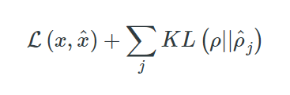
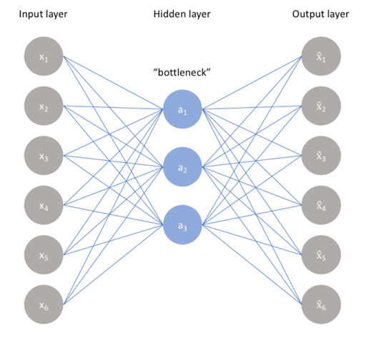
Network Loss Function (KL divergence term included)

Slide 8
Cluster Analysis.
Hierarchical Clustering (squared Euclidean and city-block distance measures).
K-means (squared Euclidean and city-block distance measures).
Optimal K value is found by checking:-
if individual clusters are homogenous and
(b) if they are well-separated from the other clusters.
Internal Cluster Evaluation
*To Judge how well the clustered data fit within the candidate k clusters.
*silhouette, Calinski-Harabasz(CH) criteria were used to evaluate.

Slide 9
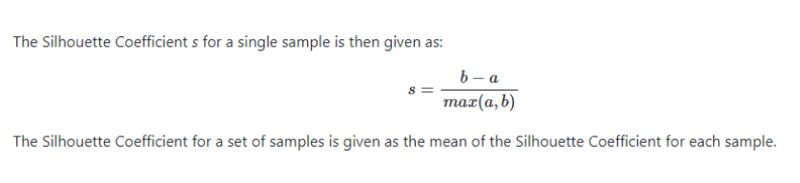
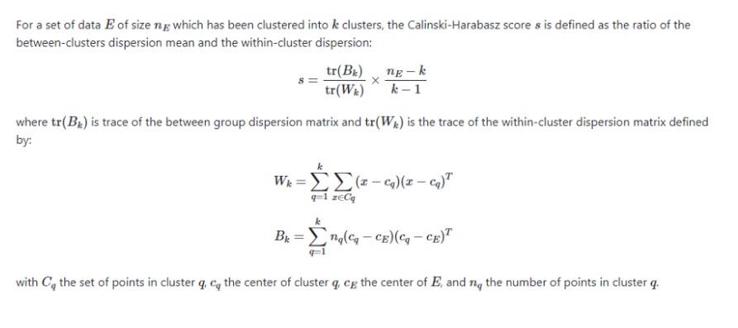
Silhouette Score
Calinski-Harabasz(CH) criteria

Slide 10
External Cluster Evaluation
Important feature other than the one present in the 32 feature is used. Here bone mineral density and incident hip fracture risk is used as these are key proxies of osteoporosis risk and indication for anti-osteoporosis drug therapy.
Results of Feature Selection and Cluster Analysis
Feature Selection From 12 variables
From the subset of 12 variables, the autoencoder assigned high weights (wij > 0:5 ) to 8 of the 12 variables. The same 8 identified by the expert except the alcohol consumption, which the autoencoder did not rank highly.
Feature Selection Selecting From 32 Variables
10 variables were selected. 7 of the 8 variables, Steroid use was not ranked highly. additional 3 variables are: varicose veins, type 2 diabetes and cancer.
When selecting from both the 12-variable subset and the 32-variable full dataset, the ranking of the selected variables did not exactly match their prevalence in the dataset. However, in both scenarios, the features with the highest prevalence in the dataset were all selected

Slide 11
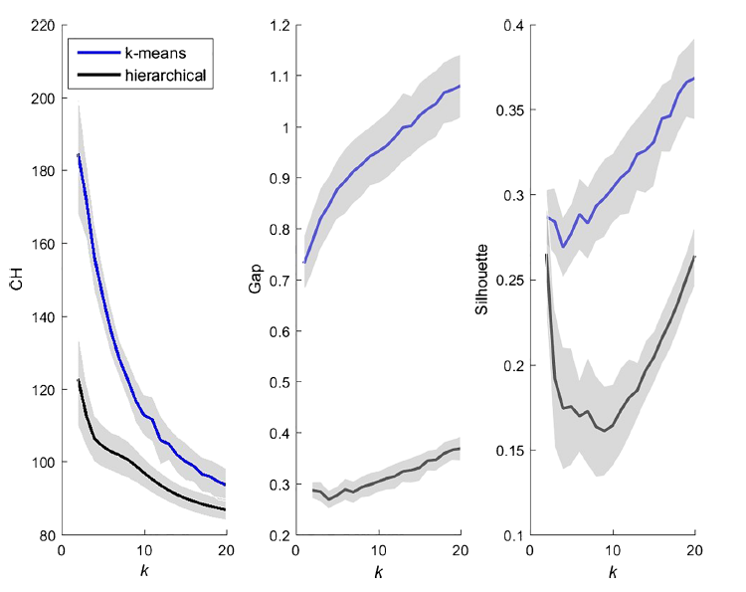
Cluster Analysis and Evaluation

Slide 12
For both k-means and hierarchical clustering, CH decreased from k = 2 onward, suggesting k= 2. The smallest gap resulted when k = 2 for both k-means and hierarchical clustering and, as k increased, no clear elbow point was found to show where the gap was maximized.
The silhouette criterion showed similar results to the gap criterion for k-means (indicating better clustering as k increased). However, for hierarchical clustering, it suggested that the clustering solution initially became worse as k increased from k = 2 to k = 4, stabilised from k = 5 and became worse again at k = 8.
This demonstrates that the hierarchical and k-means clustering did not necessarily agree in their clustering solution. It also shows that there was no clear elbow point or stable state on the evaluation curves.
We thus cannot conclude that there was an obvious optimal number of clusters in our data.

Slide 13
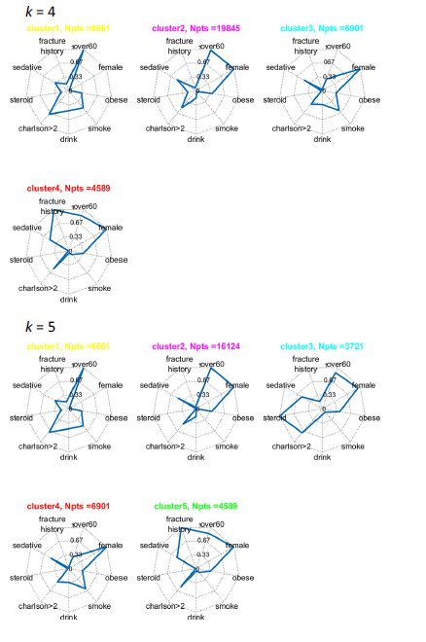
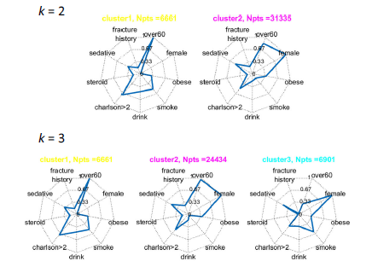
Cluster Structure

Slide 14
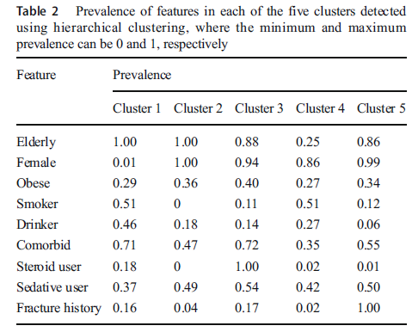
Table (k=5)

Slide 15
Characteristics of the five clusters
Cluster 1 could be referred to as the male cluster, cluster 5 could be the elderly women with fracture history, whereas cluster 4 could be referred to as younger women with no fracture history.
For the external evaluation, the fracture risk of the cluster of elderly women with fracture history (cluster 5) was, as expected, the highest (10.5/1000py) and their hip bone mineral density was the lowest (T score= − 2.2).
Clusters 1, 2 and 3 had a fracture risk of 4, 6 and 6.5 per 1000 py, respectively. Cluster 4 had a lower fracture risk (1.5/1000 py) than even the general source population (2.23/1000 py) . This also appears plausible since this cluster comprised younger people with no previousfractures. And their hip bone mineral density was higher than that of cluster 5 (Tscore = − 1.6). However, despite having a “healthy” hip T score, cluster 4 participants had an average spine bone mineral density that was low enough to be osteoporotic (T score = − 2.7), which may explain why this seemingly healthy cluster was prescribed anti-osteoporosis drugs.
In this manner, phenotyping and discovery can help us to discover new or hidden drug use patterns or sub-groups.

